Slide 1
Materialism and Brand Love
A Dimensional Analysis
Aaron Ahuvia, University of Michigan-Dearborn
Philipp Rauschnabel,Universität der Bundeswehr München
Aric Rindfleisch, University of Illinois at Urbana-Champaign
(Authors are listed alphabetically)

Slide 2
Materialism and Brands
A lot is known about materialism and well-being
A lot less is known about materialism and brands
Richins, M. L. (1994). Special Possessions and the Expression of Material Values. Journal of Consumer Research, 21 (3), 522–533.
Rindfleisch, A., Burroughs, J. E., & Wong, N. (2009). The Safety of Objects: Materialism, Existential Insecurity, and Brand Connection. Journal of Consumer Research, 36 (1), 1–16.

Slide 3
Materialism (Richins 2004)
SUCCESS
The things I own say a lot about how well I'm doing in life.
I like to own things that impress people.
CENTRALITY
I try to keep my life simple, as far as possessions are concerned. (R)
The things I own aren't all that important to me. (R)
HAPPINESS
My life would be better if I owned certain things I don't have.
It sometimes bothers me quite a bit that I can't afford to buy all the things I'd like.

Slide 4
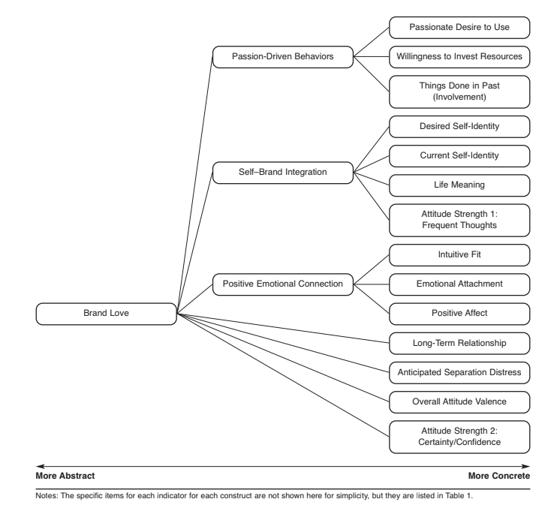
Brand Love
Six item brand love short scale
I feel emotionally connected to my favorite brands.
I expect that my favorite brands will be part of my life for a long time to come.
If my favorite brands were to go out of existence, I would feel bad.
My overall feelings towards my favorite brands are positive.
My favorite brands say something ‘true’ and ‘deep’ about whom I am as a person.
I feel myself desiring my favorite brands.
A 13 and a 26 item scale are also available that allow you to look at each of the 13 lower order factors individually.
Bagozzi, R. P., Batra, R., & Ahuvia, A. C. (2016). Brand Love: development and validation of a practical scale. Marketing Letters, 28, 1–14.
Notes:
https://news.samsung.com/global/interview-younghee-lee-cmo-of-samsung-electronics-discusses-the-intelligence-of-things-a-new-era-of-connectivity

Slide 5
Four Studies
Study 1. German online survey recruited via social media (n=283, 47% female, age: m=26.7, SD=6.9 years). Brand love for car (n=143) or phone (n=140). Surveyed both about their specific possession (i.e. their actual phone or car) as well as love for its brand. Also brand love for “money” as the focal brand (all α>.80).
Study 2. Respondents (n=270, 47% female, age: m=36.5, SD=11.5 years), American MTurk, brand love for “your favorite brands” as a group (α=.84).
Study 3. US business students (n=342, 46% females, age: 23.0, SD=5.9 years). Brand love for Lexus, Armani, Whole Foods, Hagen Dasz, and Facebook.
Study 4. US MTurk study, N=720. Respondents asked to Name three brands that you love or come closest to love.

Slide 6
Love for Money from Study 1
Brand Love | Study 2, STD Betas Love of Money
Mat-success | .400
Mat-centrality | .212
Mat-happiness | .197
Age | n.s.
Gender (0=male, 1=female) | -.121
R² | .517

Slide 7
Love for “Your Favorite Brands” from Study 2
 | Study 1, STD Betas Love for . . .
 | Brands in general
Mat-success | .273
Mat-centrality | .303
Mat-happiness | n.s.
Age | n.s.
Gender (0=male, 1=female) | .138
R² | .287

Slide 8
Love for Respondents’ Possessions and Corresponding Brands from Study 1
 | Study 2, STD Betas Brand love for . . .
 | Cars and Phones together | Car Brands Only | Phone Brands Only | My Car | My Phone
Mat-success | .318 | .248 | .377 | n.s. | .332
Mat-centrality | n.s. | n.s. | n.s. | n.s. | n.s.
Mat-happiness | n.s. | n.s. | n.s. | n.s. | n.s.
Age | n.s. | n.s. | n.s. | -.205 | n.s.
Gender (0=male, 1=female) | n.s. | n.s. | n.s. | n.s. | .196
R² | .140 | .094 | .141 | .133 | .172

Slide 9
Love for Researcher Chosen Brands from Study 3
 | Study 3, STD Betas Brand love for . . .
 | Lexus | Armani | Whole Foods | Hagen Dasz | Facebook
Mat-success | n.s. | .128 | n.s. | n.s. | n.s.
Mat-centrality | .314 | .344 | .183 | .173 | n.s.
Mat-happiness | n.s. | n.s. | n.s. | n.s. | .163
Age | n.s. | n.s. | n.s. | n.s. | n.s.
Gender (0=male, 1=female) | n.s. | n.s. | .146 | .125 | .218
R² | .396 | .427 | .313 | .300 | .331

Slide 10
Brand Love’s Long Tail (Study 4)

Slide 12
Top 10 Brands from Study 4
Overall | High Success | High Centrality | High Happiness
Apple | Apple | Apple | Apple
Nike | Nike | Nike | Nike
Samsung | Samsung | Samsung | Samsung
Amazon | Adidas | Adidas | Adidas
Adidas | Coca-Cola | Amazon | Amazon
Coca Cola | Amazon | Microsoft | Google
Google | Google | Coca-Cola | Coca-Cola
Sony | Microsoft | Google | Sony
Microsoft | Sony | Sony | Microsoft
Nintendo | Nintendo | Nintendo | Nintendo

Slide 13
Key Findings
Love of money is significantly related to all three materialism dimensions.
Brand love for typical commercial brands is often related to mat-centrality and/or mat-success, but almost never related to mat-happiness (the only exception being brand love for Facebook).
Brand love has an extremely long tail, i.e. people love a very wide variety of brands.
The brands most loved is quite consistent across all three dimensions. However, the few differences that arise exhibit distinctive patterns across the three dimensions.

